Slide 1
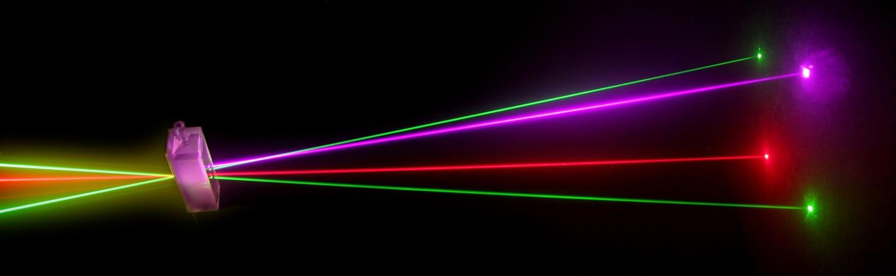
“Laser Technology and Applications” 16B1NPH533 Lecture 18
Notes:
1

Slide 2
Lecture 18 Content Outlines
Modes of a Rectangular Cavity and the Open Planar Resonator

Slide 3
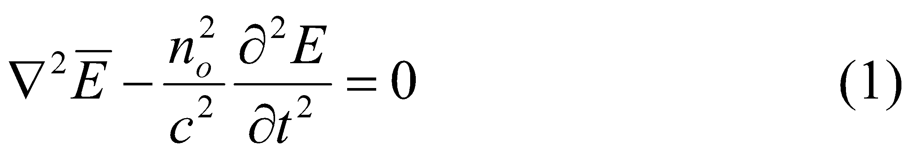
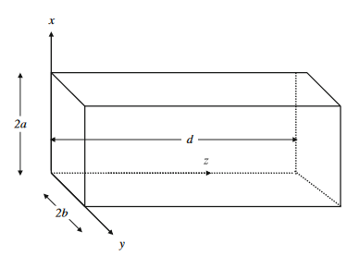
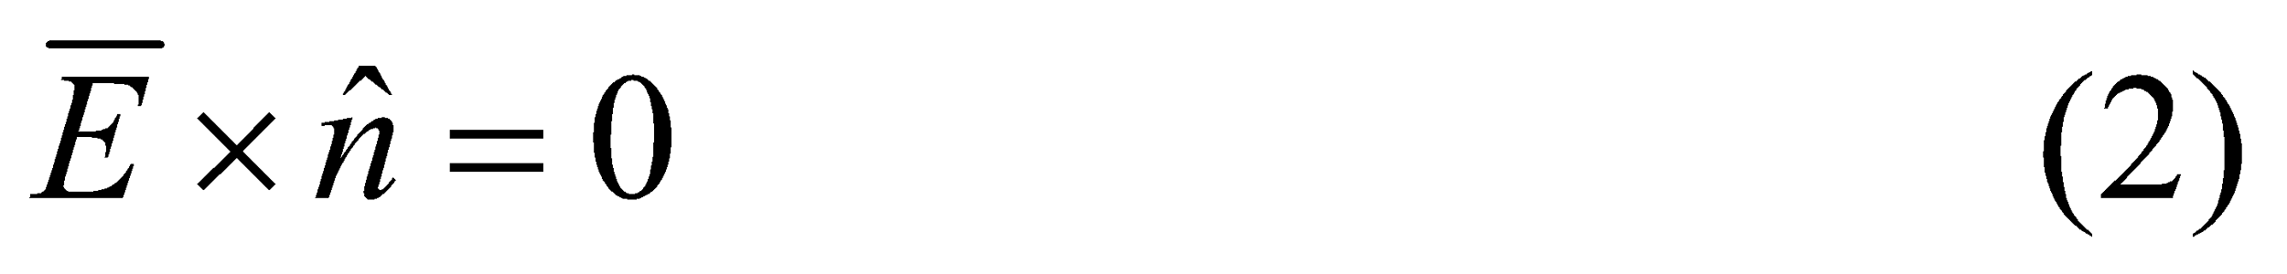
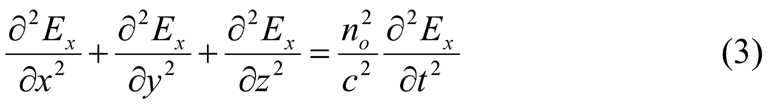
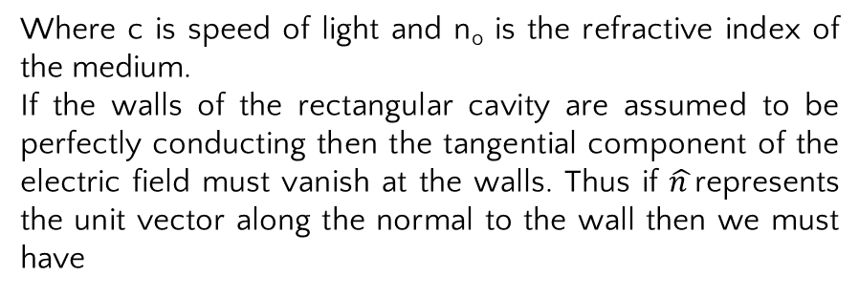
The optical resonator, consists of a pair of mirrors facing each other in between which is placed the active laser medium which provides for optical amplification. the mirrors provide optical feedback and the system then acts as an oscillator generating light rather than just amplifying.
Modes of a Rectangular Cavity
Consider a rectangular cavity of dimensions 2a×2b×d. Starting from Maxwell’s equations the electric and magnetic fields satisfy a wave equation of the form given by
Where c is speed of light and n_{o} is the refractive index of the medium.
If the walls of the rectangular cavity are assumed to be perfectly conducting then the tangential component of the electric field must vanish at the walls. Thus if $\hat{n }$represents the unit vector along the normal to the wall then we must have
on the walls of the cavity. Let us consider a Cartesian component (say x component) of the electric vector ; this will also satisfy the wave equation, which in the Cartesian system of coordinates will be given by

Slide 4
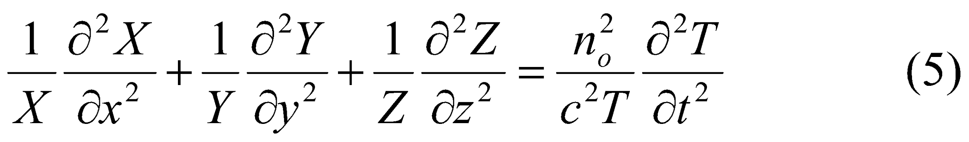
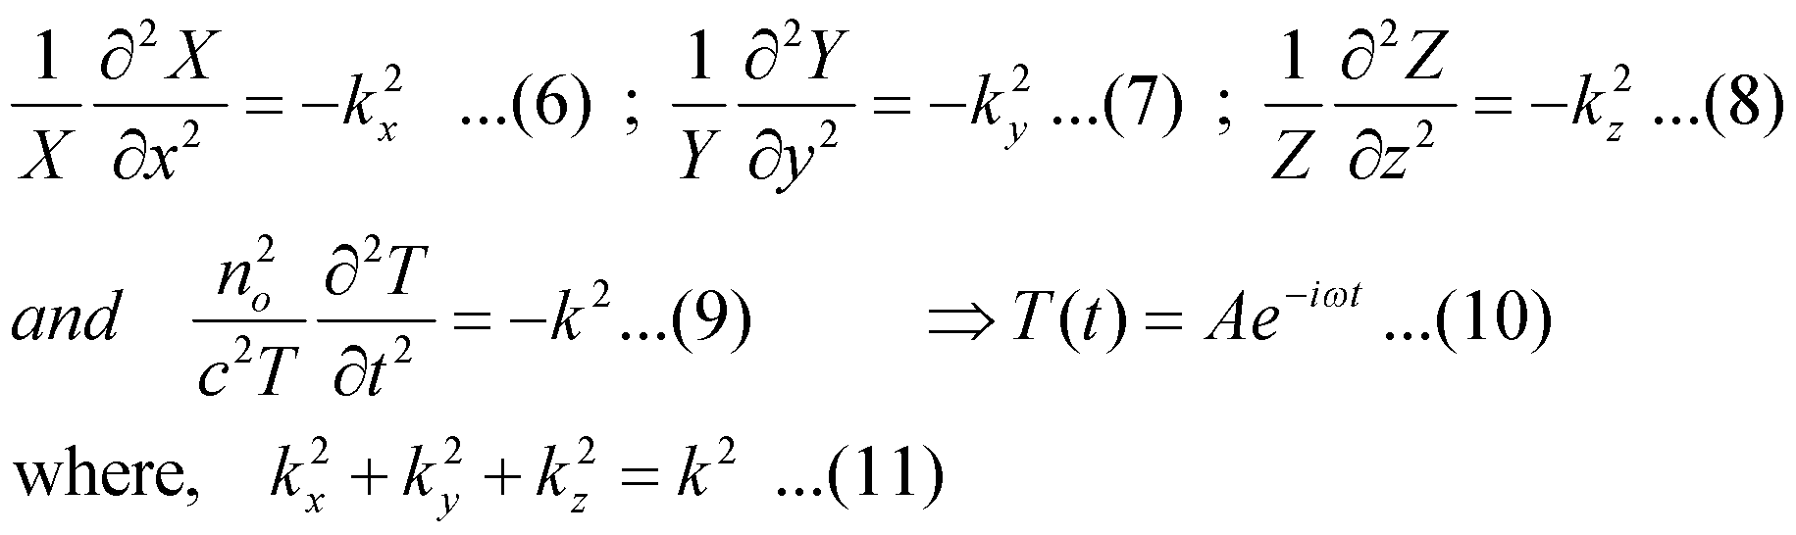
we use the method of separation of variables to solve equation 3 and write
E_{x}=X(x)Y(y)Z(z)T(t) (4)
Substituting this in Eq. (3) and dividing by E_{x} We obtain
For oscillating solution , we get
Where ω=ck/n₀ represents the angular frequency of the wave and A is a constant. It should be mentioned that we could equally well have chosen the time dependence to be of the form e^{iωt}. Since E_{x} is a tangential component on the planes y=0,y=2b, z=0, and z=d, it has to vanish on these planes and the solution of Eqs. (7)and (8)would be sink_{y}y and sink_{z}z,(oscillatory solution)
respectively, with

Slide 5
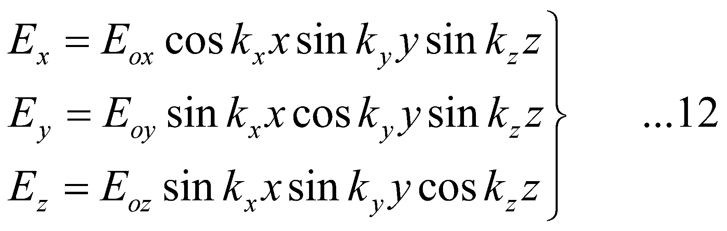
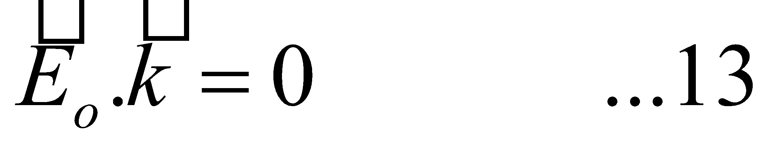
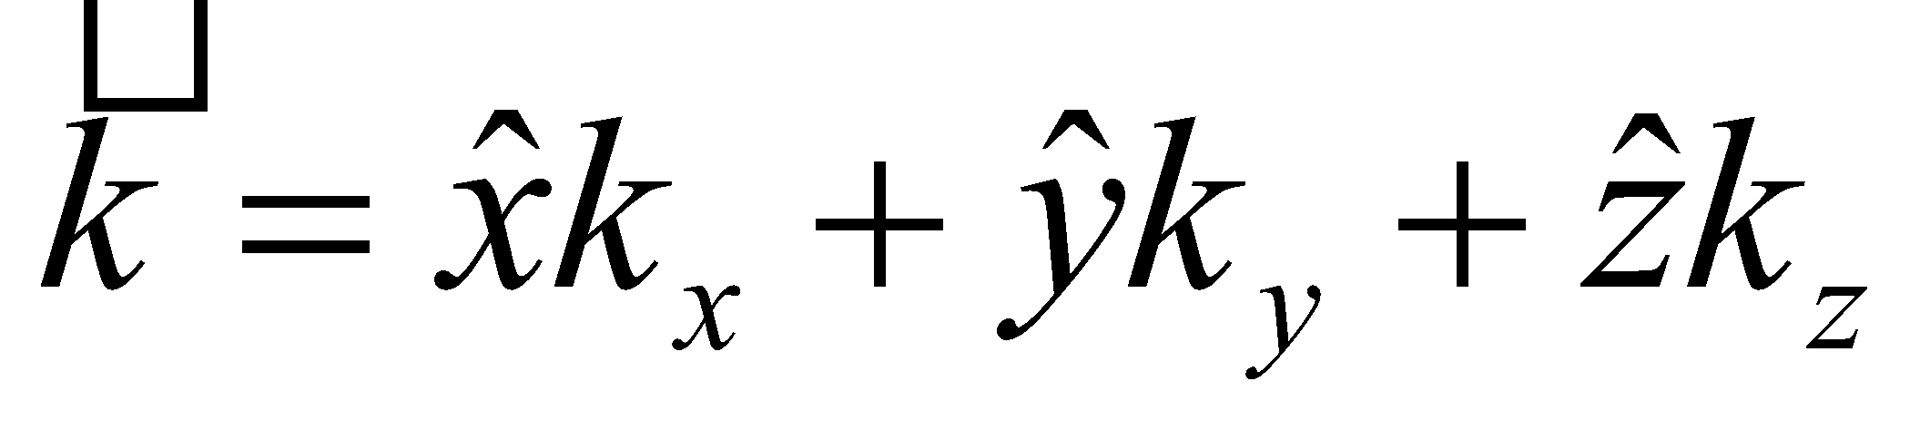
Now, because of the above forms of the x dependence of E_{y} and E_{z}, ∂E_{y}/∂y, and ∂E_{z}/∂z would vanish on the surfaces x=0 and x=2a. Thus on the planes x=0 and x=2a, the equation ∇.E=0 leads to ∂E_{x}/∂x=0.Hence the x dependence of E_{x} will be of the form cosk_{x}x. Notice that the case m=0 now corresponds to a nontrivial solution. In a similar manner, one may obtain the solutions for E_{y} and E_{z}. The complete solution (apart from the time dependence) would therefore be given by
Where E_{0x},E_{0y}, and E_{0z} are constants. The use of Maxwell’s equation ∇.E=0, immediately gives
Where . Since the coefficients E_{0x} , E_{0y} and E_{0z} have to satisfy Eq. (12) it follows that for a given mode, i.e., for a given set of values of m, n, and q only two of the components of E₀ can be chosen independently. Thus a given mode can have two independent states of polarization .Note that when one of the quantities m, n, or q is zero, then there is only one possible polarization state associated with the mode. Thus if we consider the use with m=0,n ≠ 0,q ≠ 0, then E_{x}=E_{0x}sink_{y}ysink_{z}z, E_{y}=0, E_{z}=0. Thus the only possible case is with the electric vector oriented along the x-direction

Slide 6
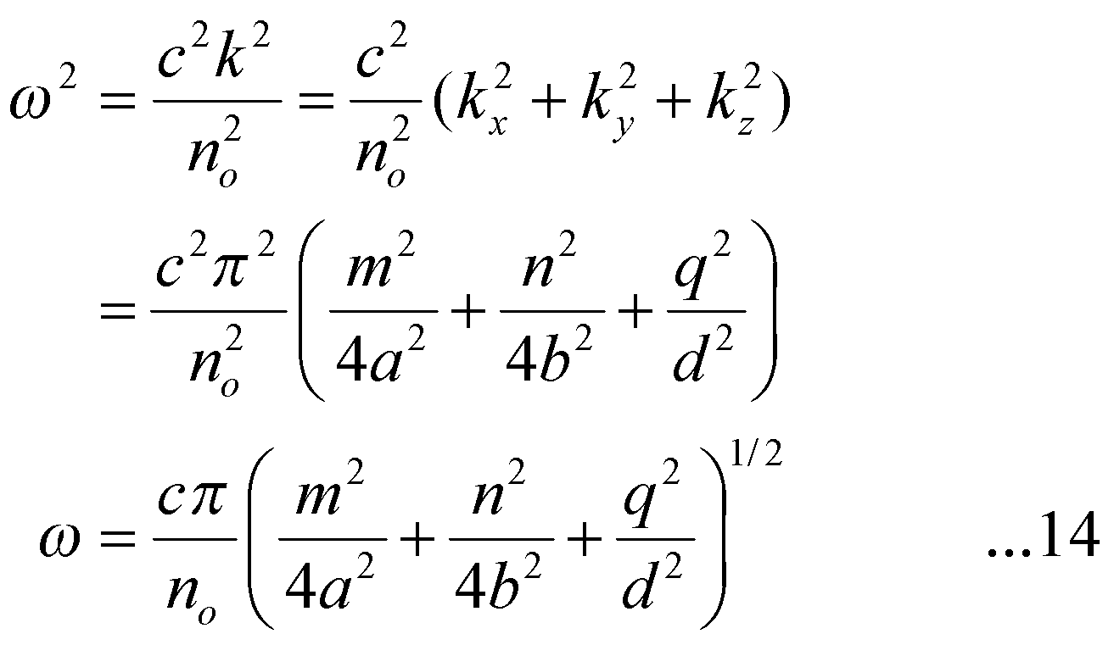
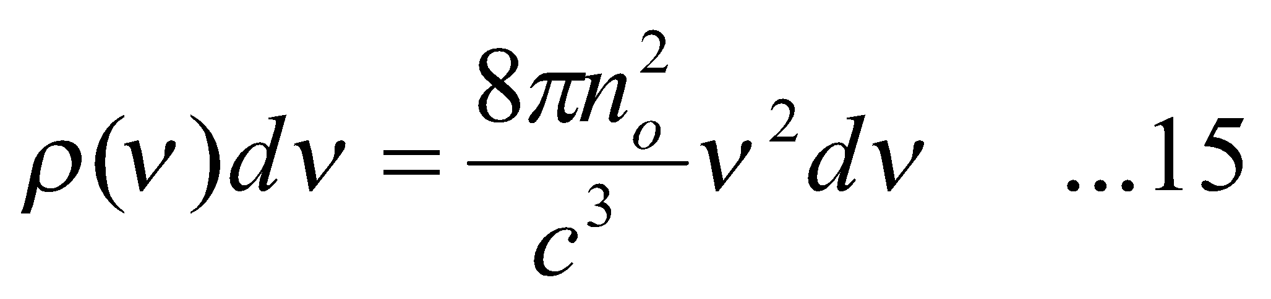
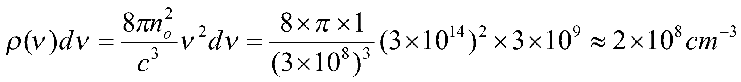
Using above equations, we get
which gives us the allowed frequencies of oscillation of the field in the cavity. Field configurations given by Eq. 12 represent standing wave patterns in the cavity and are called modes of oscillation of the cavity. These are similar to the acoustic modes of vibration of an acoustic cavity and represent the only possible frequencies that can exist within the cavity.
Using Eq. (14) ,the number of modes per unit volume in a frequency interval from ν to ν+dν will be given by
Where n₀ represents the refractive index of the medium filling the cavity. For a typical atomic system dν∼3×10⁹Hz at ν=3×10¹⁴Hz and the number of modes per unit volume would be (assuming n₀=1)

Slide 7
Thus for cavities having typical volumes of 10 cm³, the number of possible oscillating modes within the linewidth will be 2×10⁹ which is very large. To achieve a very small number of possible oscillating modes within the linewidth of the atomic transition, the volume of the cavity has to be made very small.
In the case of conventional lasers the volume of the cavity is large and thus the number of oscillating modes within the linewidth of the atomic transition is very large. Thus the emission would be far from monochromatic.
If the dimensions of the cavity are chosen to be of the order of the wavelength, then the volume of the atomic system available for lasing becomes quite small and the power would be quite small.
The problem of the extremely large number of oscillating modes can be over-come by using open cavities(as against closed cavities) .

Slide 8
Since the resonator cavity is now open, all modes would be lossy. Thus even the modes that have plane wave components traveling almost along the z-direction will suffer losses. Since m and n specify the field patterns along the transverse directions x and y and q that along the longitudinal direction z, modes having different values of (m,n) are referred to as various transverse modes while modes differing in q-values are referred to as various longitudinal modes.

Slide 9
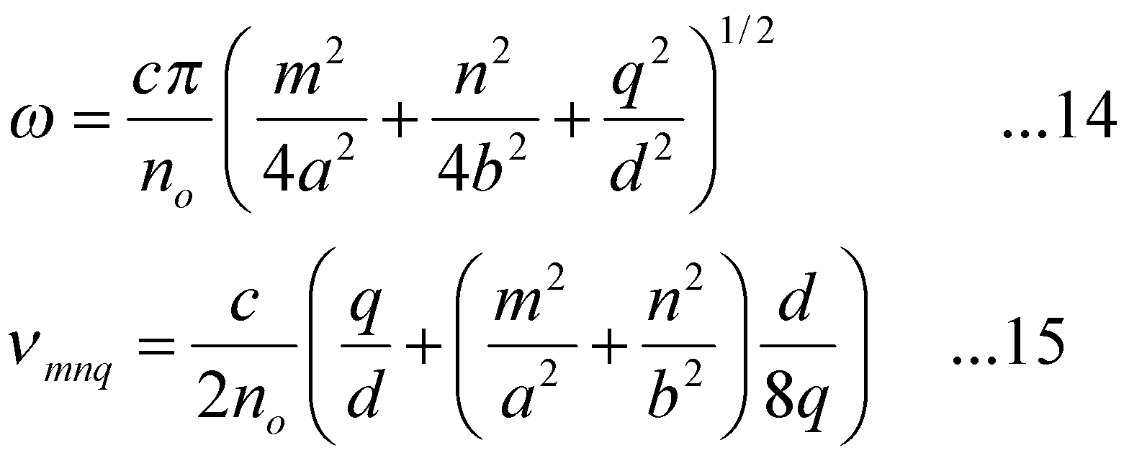
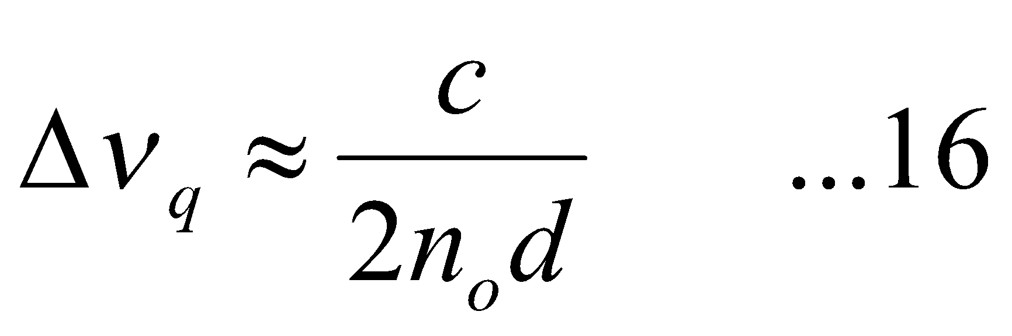
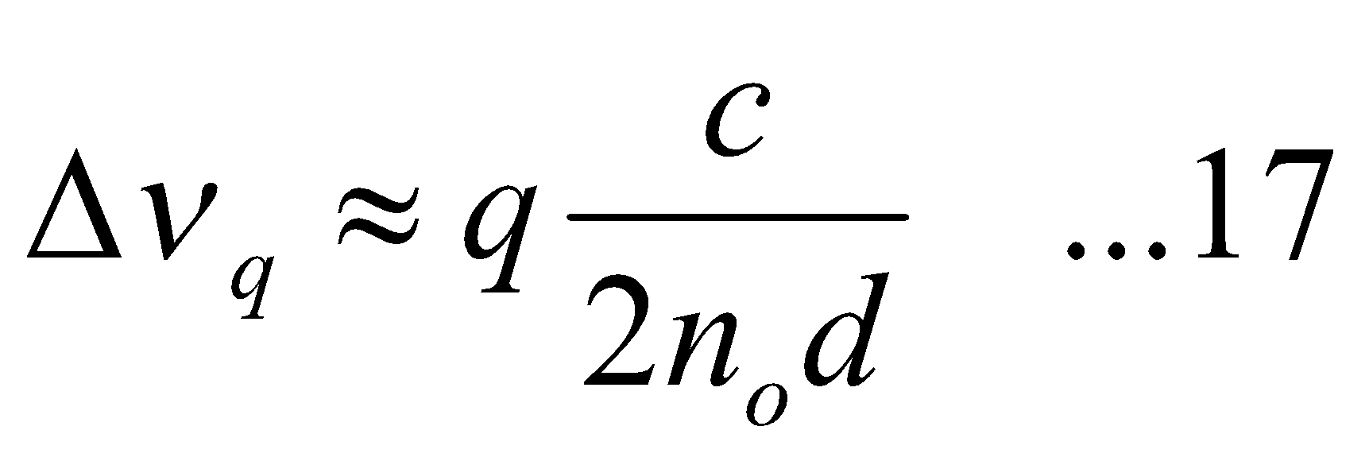
The oscillation frequencies of the various modes of the closed cavity are given by Eq. (14 ). In order to obtain an approximate value for the oscillation frequencies of the modes of an open cavity, we may again use Eq. (14) with the condition m,n<<q. Thus making a binomial expansion in Eq. (14) we obtain
The difference in frequency between two adjacent modes having same values of m and n and differing in q value by unity would be very nearly given by
which corresponds to the longitudinal mode spacing. In addition if we completely neglect the terms containing m and n in Eq. (15) we will obtain
The above equation is similar to the frequencies of oscillation of a stretched string of length d.

Slide 10
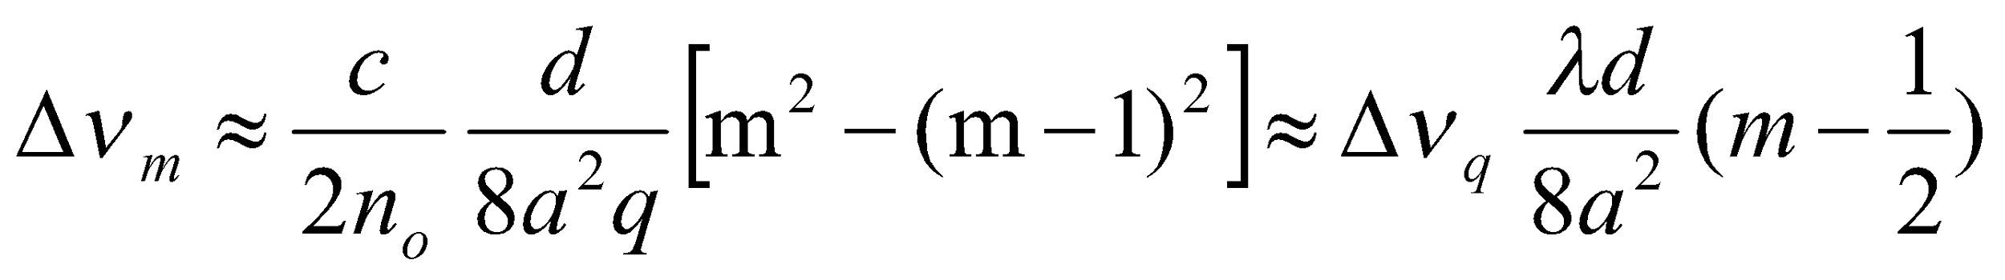
🕮 For a typical laser resonatord∼100 cm and assuming free space filling the cavity, the longitudinal mode spacing comes out to be∼150 MHz which corresponds to a wavelength spacing of approximately 0.18 pm (=0.18×10^{–12} m) at a wavelength of 600 nm.
🕮 Show that the separation between two adjacent transverse modes is much smaller than Δν_{q}.
Solution The frequency separation between two modes differing in m values by unity would be
Where we have used q ≈ 2d/λ . For typical values of λ=600 nm, d=100 cm, a=1cm, λ/d8a²=7.5×10⁻⁴. Thus for m∼1,, Δν_{m} << Δν_{q}.

